Slide 1
Jays preso

Slide 2
Presentation structure
Data prep
EDA
Model building
Testing forecasts from final model
Potential improvements
Notes:
But add into final models to check if explanatory power

Slide 3
Data prep & EDA

Slide 4
Data cleaning
Removed x vars due to missing values
NAs: ~0.2% of load and ~4% of climate data. Interpolated to allow time series analysis
A priori decision to exclude wind data, at least from initial models, since it shouldn’t affect demand and will only minimally affect supply
Notes:
But add into final models to check if explanatory power

Slide 5
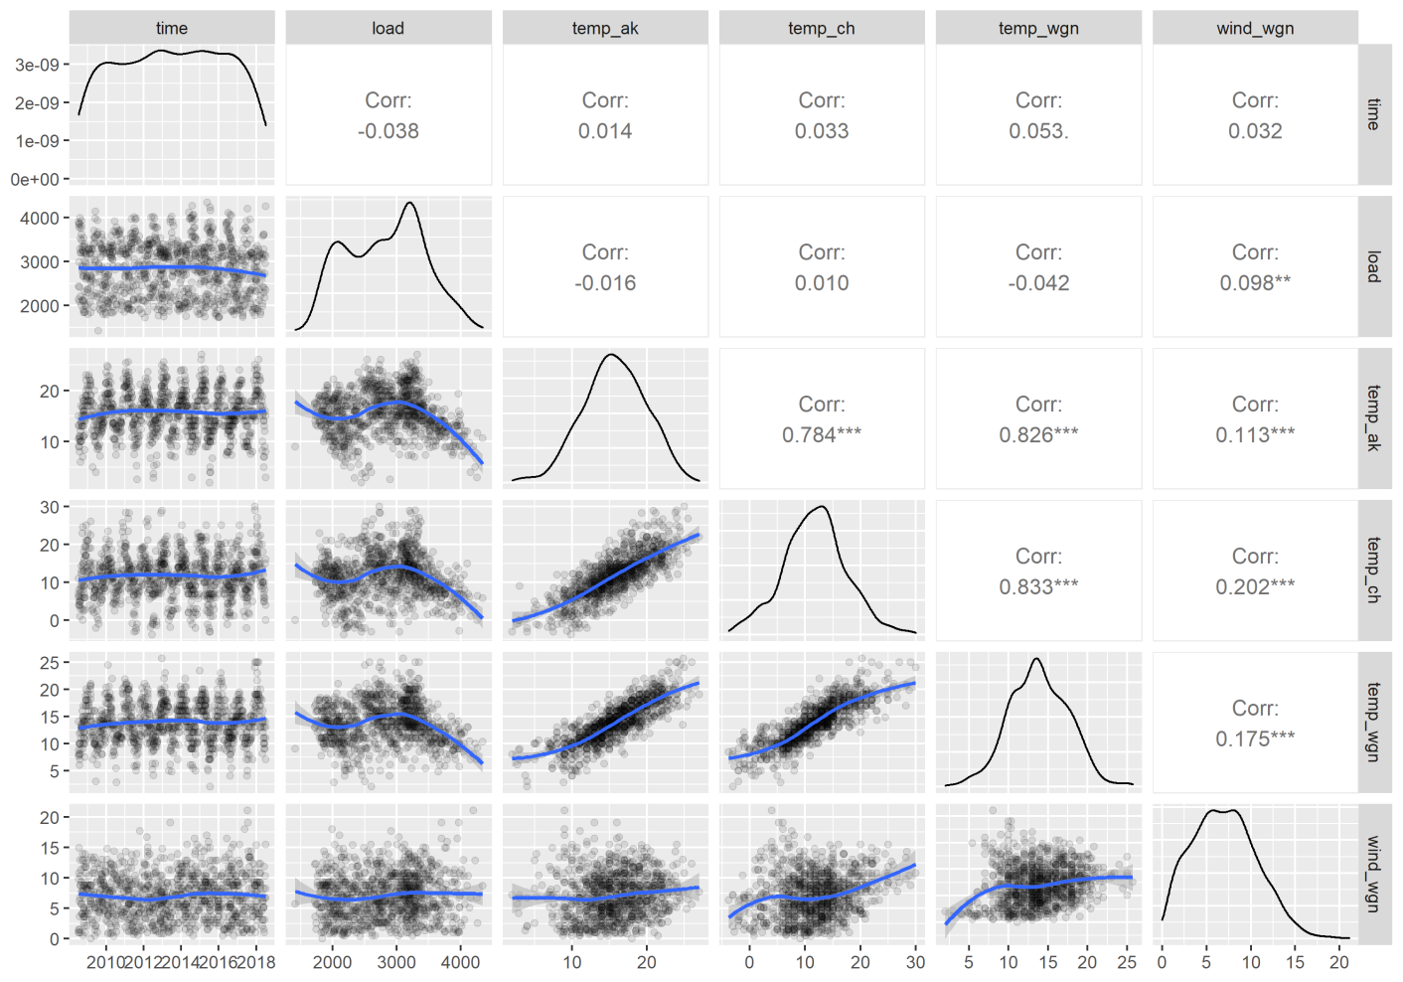
EDA | basic correlations
Strong temp correlations between ak, ch & wgn → only use ak (where most power is consumed)
Notes:
Ak most likely to affect load, cos where most NI ppl are from

Slide 6
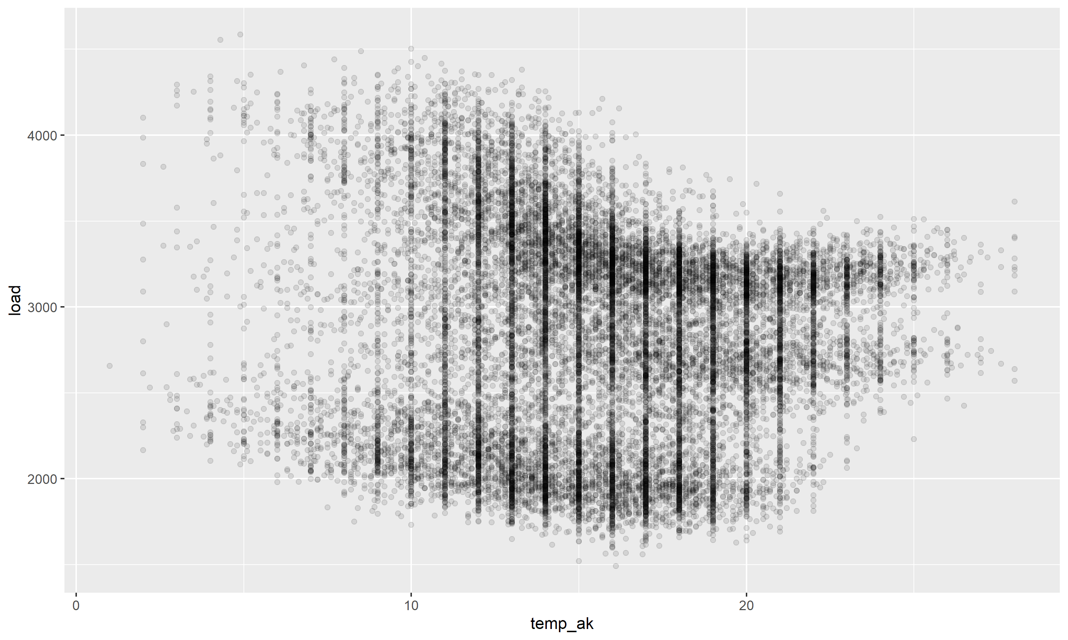
EDA | load vs temperature
Weak, nonlinear relationship with obvious patterning... Clearly other factors at play

Slide 7
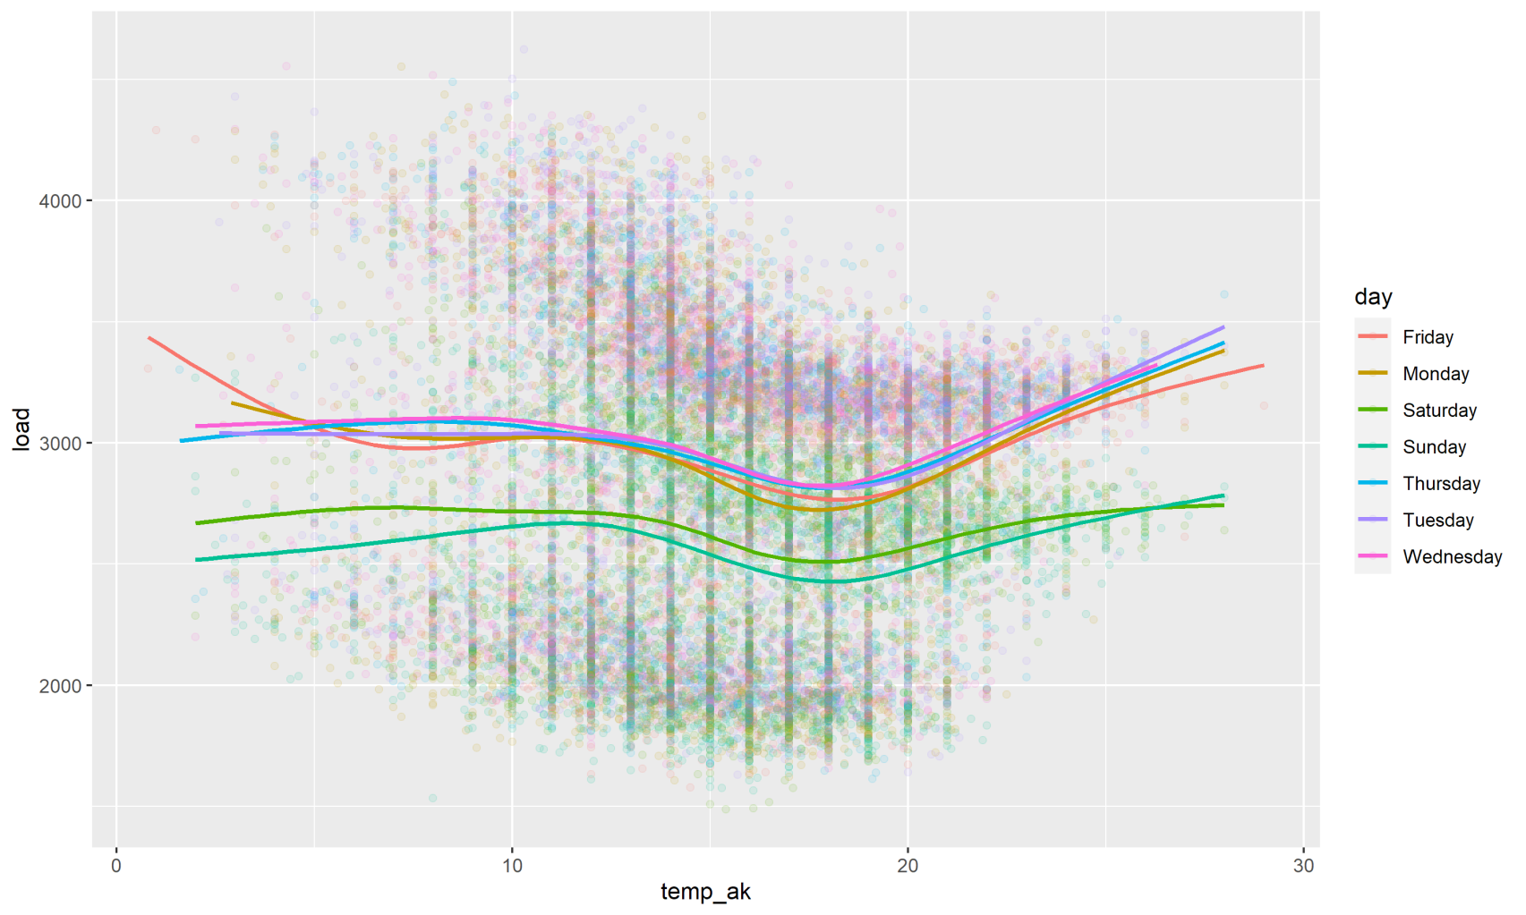
EDA | load vs temperature
Day of week explains a small part of the variation
Notes:
Slight interaction effect at least for Saturday and Sunday vs other days above 18 degrees: above this point temperature increases are more likely to increase load on a weekday (businesses putting Aircon on?).

Slide 8
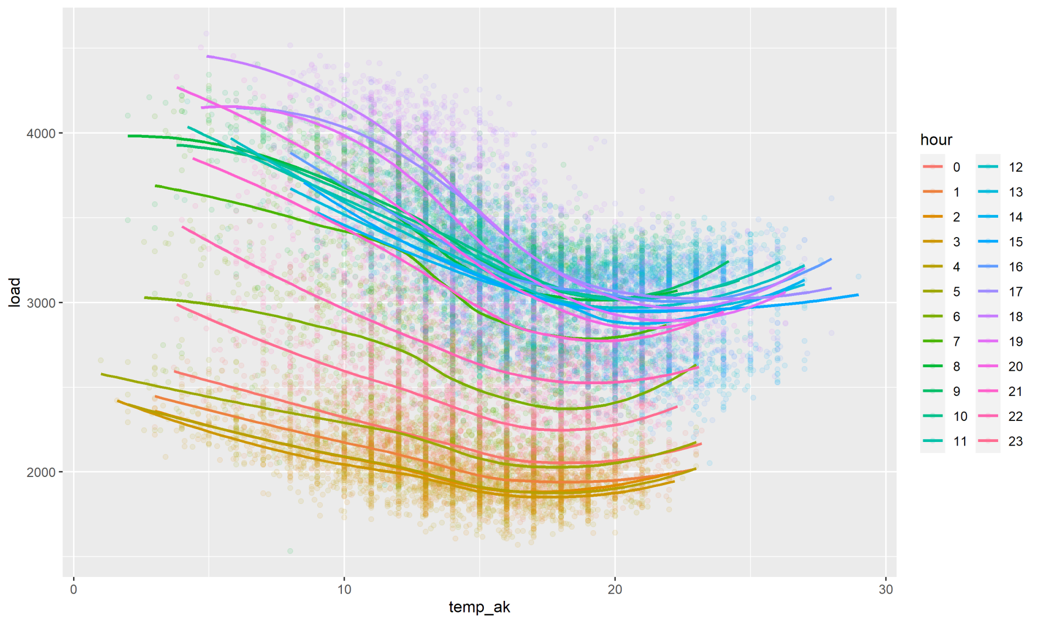
EDA | load vs temperature
Interaction between hour and temperature is the main driver of load

Slide 9
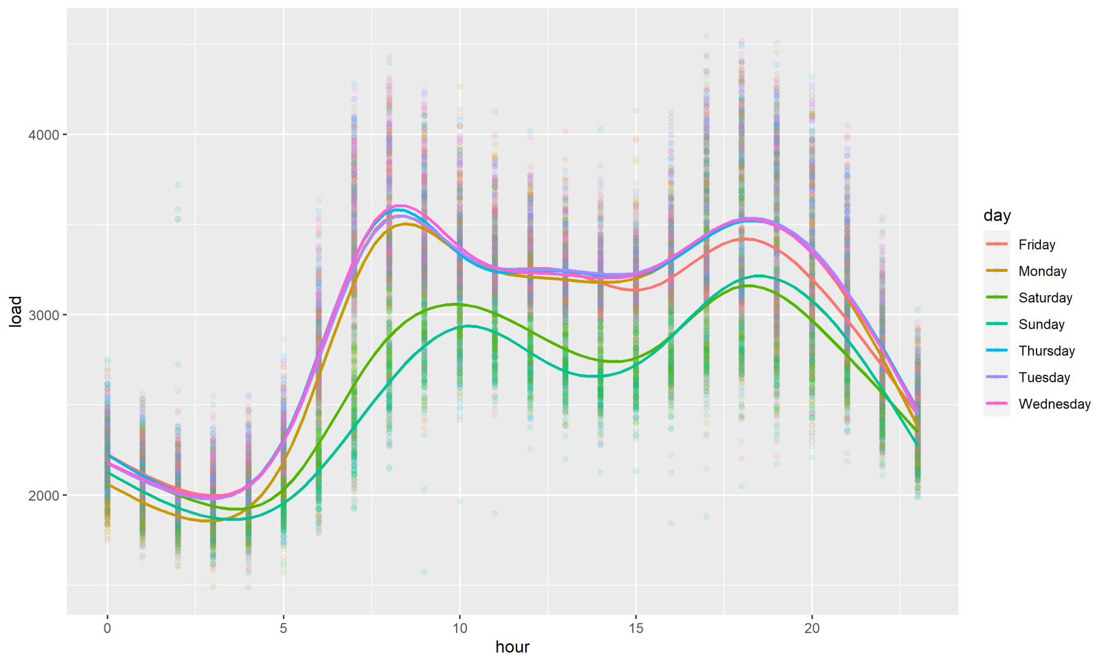
EDA | hourly energy use
Clear peaks in use and an interaction with day
Notes:
Lower use on the weekend for a given hour, reduced peak hour effect, and Monday morning and Friday night behave more like a weekend

Slide 10
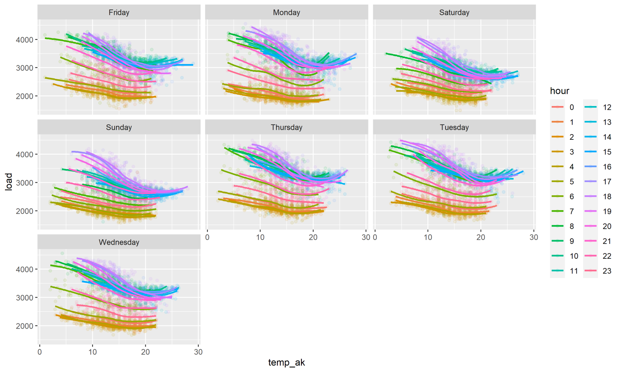
EDA | higher order interactions
Steeper slopes during daytime hours Mon-Thurs > Fri > Weekend
Notes:
The effects of temperature and our on load appear constant across days of the week?? OR steeper slopes in daytime hours Mon-Thurs

Slide 11
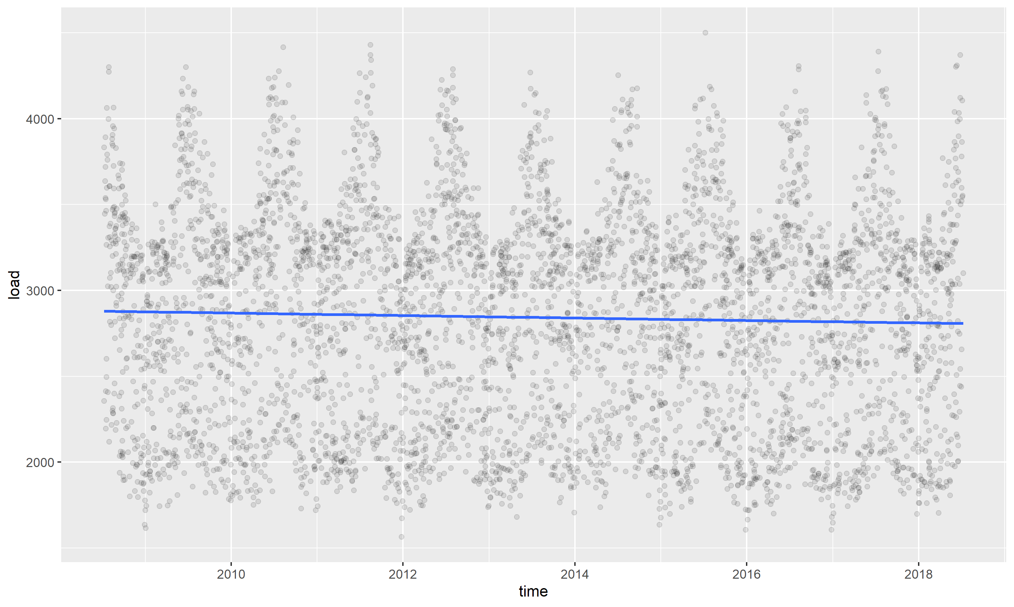
EDA | long-term trends
Linear decline in use 2008-2018

Slide 12
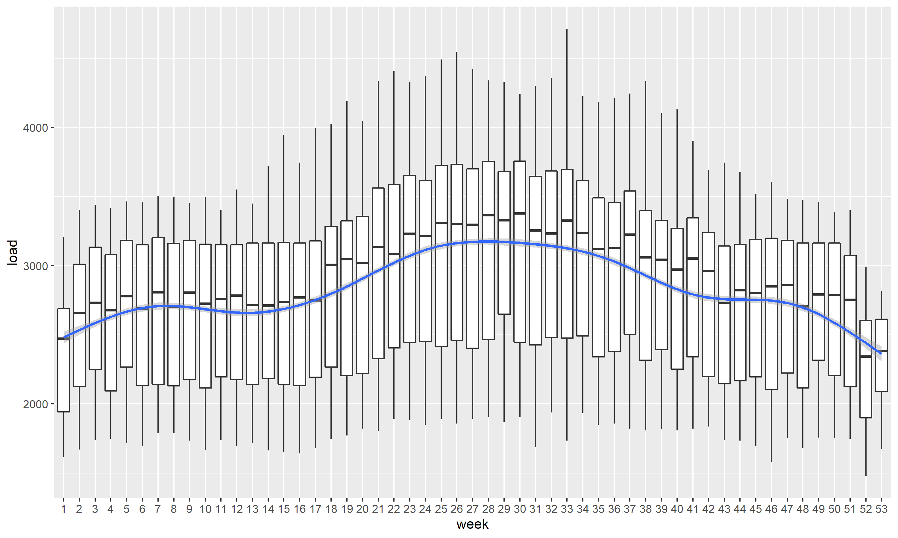
EDA: long-term trends
Clear seasonality, plus a stepchange in use over xmas
Notes:
Note the smooth can’t handle the step change. Also seasonalityoutside of holiday period is presumably just temperature driven.

Slide 13
EDA: implications for modelling
A model should include the following:
Non-linear temperature effect
Non-linear hour effect
Interaction between temperature and hour
Day effect, ideally with interactions with temperature and hour
Possibly a higher-order interaction between temperature, day, and hour
Linear long-term trend
Seasonality dummy to account for stepchange over Xmas/New Year break
Notes:
Top three are the most important and will explain most of the variation in the data

Slide 14
MODEL BUILDING
Notes:
Preliminary, as in model validation may suggest more is required

Slide 15
Approach
10 yrs of data provided
Used yrs 4-9 for model building
Judge model performance with residual plots (model validity) and AIC (predictive performance)
Measure forecast performance of winning model with using step-ahead cross-validation:
Train on years 4-9, then test on first week of year 10
Step forward one week for training and test sets
Repeat 52x until all of year 10 has been tested
Test criterion: MAPE
Notes:
Cross validation would obviously be better for predictive performance, but AIC was good for quick prototyping.
Used five years of data for model training because this was a balance between sufficient data for training and avoiding changes in relationships over time

Slide 16
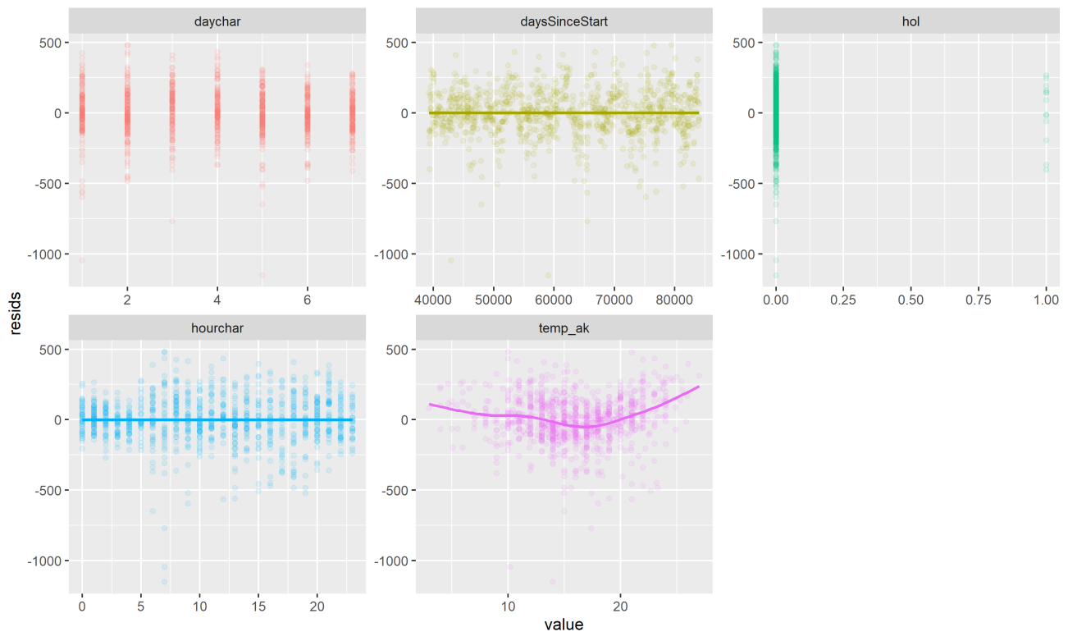
Model building: MR with interactions
Can interactions overcome non-linear temperature effect?
No!

Slide 17
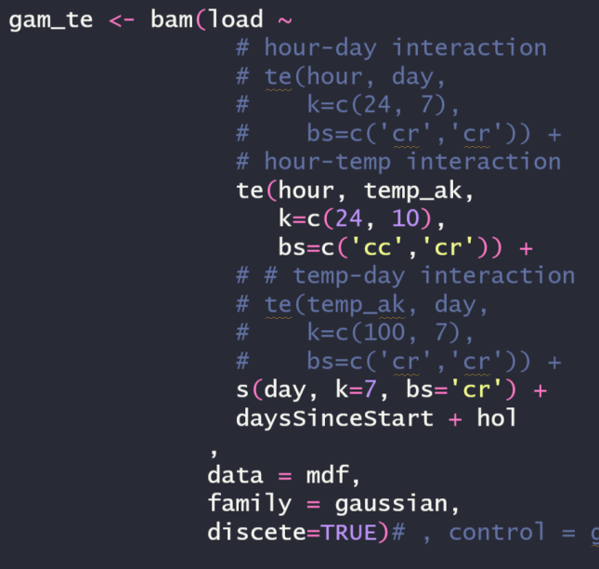
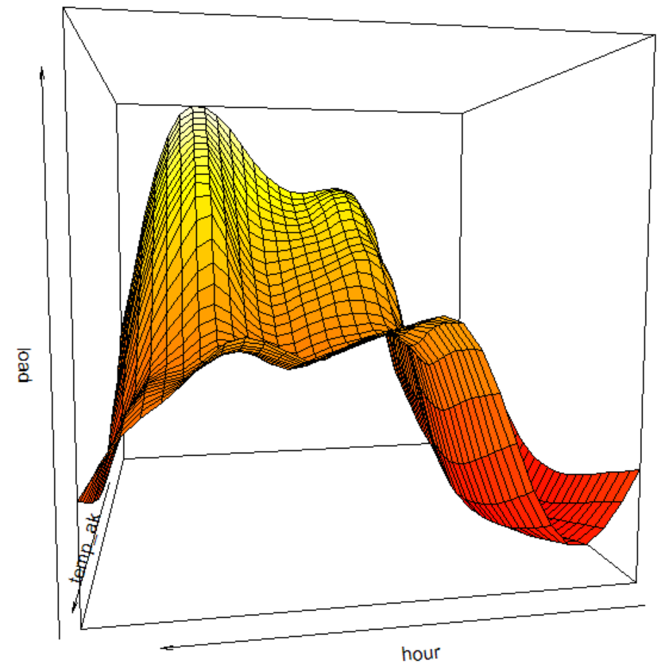
Model building: GAMs
Good for nonlinear relationships, but could only include one interaction term due to massive memory footprint
Captured temperature x hour relationship well, but overall fit was worse than MR model due to lack of interactions
Notes:
Generalised additive models, which allow spline fitting with regularisation. Bad fit based on AIC

Slide 18
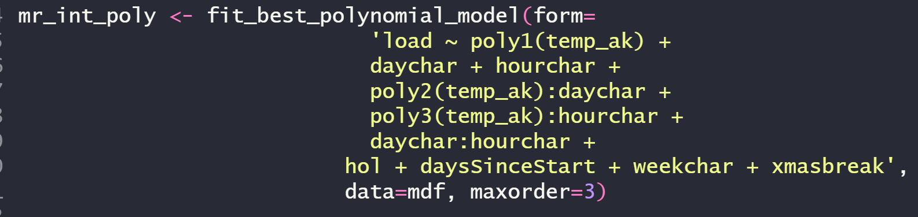
Model building: MR with polynomials
Could include all relationships that EDA indicated
Used lowest polynomial order within dAIC<2 of best model – regularisation of sorts
Better fit than other two models
Notes:
Note higher order interaction between hour/day/temp worsened fit

Slide 19
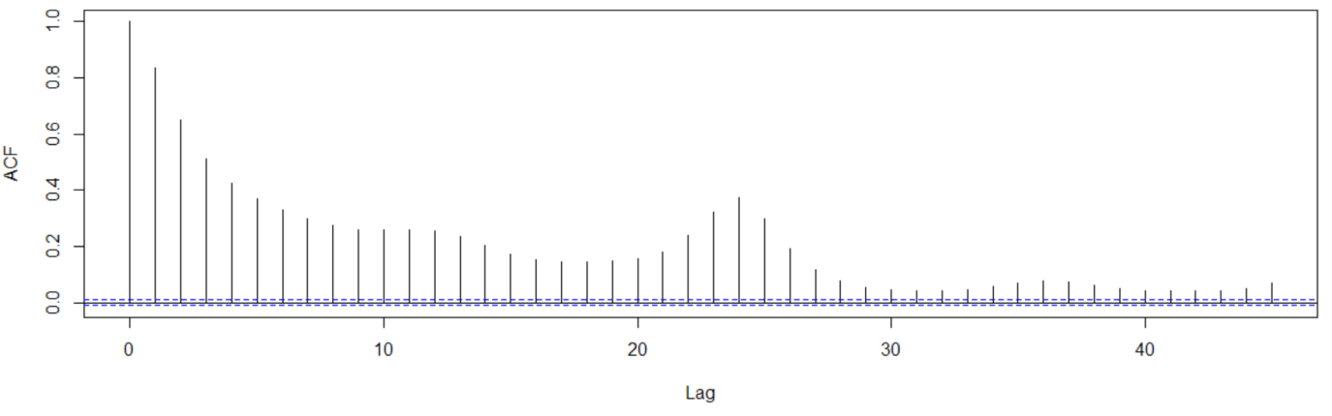
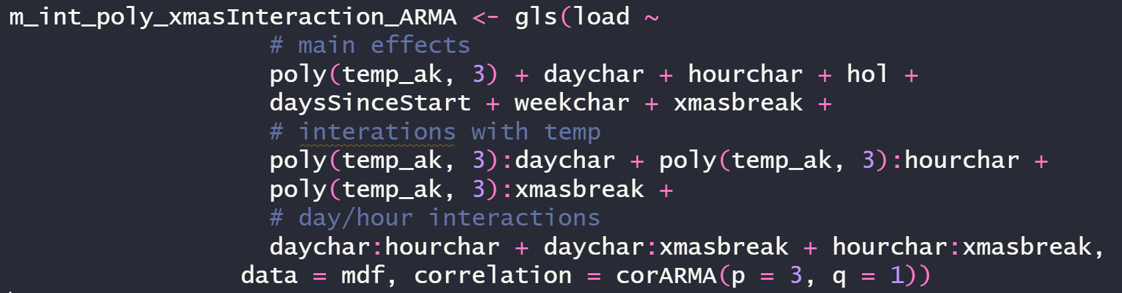
Polynomial MR extensions: ARMA errors
Clear autocorrelation in residuals.
Solution: ARMA errors
Notes:
Not a lot of data to fit this interaction, so that may still explain why predictive performance isn’t great

Slide 20
Polynomial MR extensions: ARMA errors
Clear autocorrelation in residuals.
Solution: ARMA errors
Result: memory footprint too large
Notes:
Not a lot of data to fit this interaction, so that may still explain why predictive performance isn’t great

Slide 21
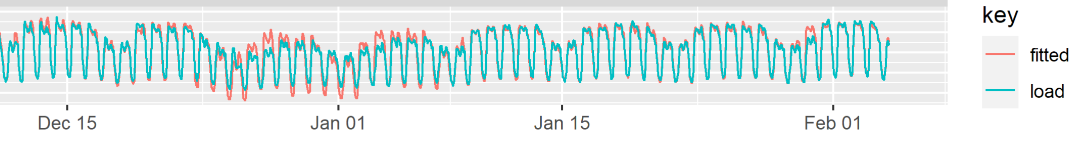
Polynomial MR extensions: holiday interaction
Residual plots generally unpatterned, but clear overestimation over christmas.
Dummy variable shifted predicted load down, but didn’t account for reduced variation.

Slide 22
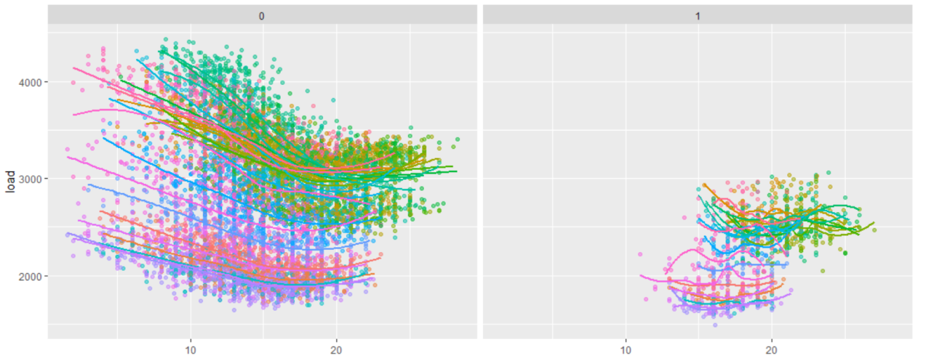
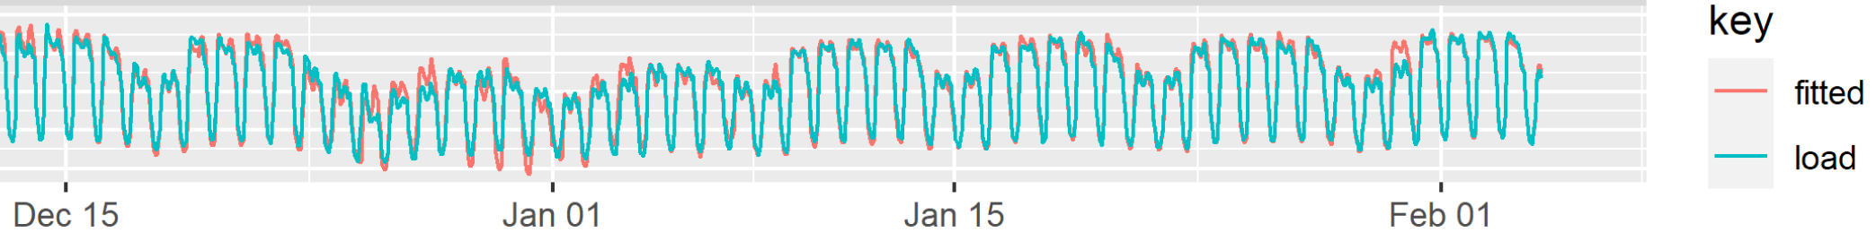
Polynomial MR extensions: holiday interaction
[Partial] solution: allow temperature and hour relationships to vary depending on period (xmas holiday vs other)
Notes:
Not a lot of data to fit this interaction, so that may still explain why predictive performance isn’t great

Slide 23
FINAL MODEL
xxx
Notes:
Not a lot of data to fit this interaction, so that may still explain why predictive performance isn’t great

Slide 24
FORECASTING
Notes:
Preliminary, as in model validation may suggest more is required

Slide 25
FINAL MODEL
xxx
Notes:
Not a lot of data to fit this interaction, so that may still explain why predictive performance isn’t great

Slide 26
Potential improvements
Notes:
Preliminary, as in model validation may suggest more is required

Slide 27
FINAL MODEL
xxx
Notes:
Not a lot of data to fit this interaction, so that may still explain why predictive performance isn’t great

Slide 28
Thank you.
Notes:
Preliminary, as in model validation may suggest more is required

